Slide 1
Smart Entertainment System Using IoT and Deep Learning
SEP 769:Cyber Physical Systems(Deep Learning)
Kenil Sachapara (400551600)
Om Kakadiya (400551508)
Yash Patel (400551627)
Jaimis Miyani (400551743)
Github Repo: Link
Under Guidance of
Anwar Mirza

Slide 2
Introduction
Overview:
Smart entertainment systems leverage Internet of Things (IoT) devices and deep learning models to provide personalized entertainment experiences.
This project aims to develop a system that analyzes data from various IoT devices, including streaming platforms and user profiles, to recommend personalized content and enhance user engagement.
Objectives:
Implement Deep Learning Models: Develop CNN and RNN models for data analysis and content recommendation.
Personalize Content Recommendations: Use user data to tailor movie and show suggestions.
Optimize Streaming Quality: Enhance streaming performance based on user device and network conditions.
Predict Viewer Behavior: Anticipate future viewing patterns to recommend relevant content.
Enhance User Engagement and Retention: Increase user satisfaction and loyalty through personalized and high-quality entertainment experiences.

Slide 3
Problem Statement
Challenges in Digital Entertainment:
Content overload: Users are overwhelmed by the sheer volume of available content.
Lack of personalization: Generic recommendations fail to cater to individual preferences.
Scalability issues: Current systems struggle to handle large user bases.
Cold start problem: Difficulty in providing recommendations to new users with limited data.
Need for Better Recommendations:
Leverage IoT and deep learning to offer personalized content suggestions.
Improve user experience and engagement through tailored recommendations.

Slide 4
Importance of Smart Entertainment System
Enhanced User Experience: Personalizes content recommendations and optimizes streaming quality for a more enjoyable and engaging viewing experience.
Increased User Engagement: Keeps users engaged with relevant content, reducing the time spent searching for something to watch.
Improved User Retention: Provides a tailored entertainment experience, increasing the likelihood of users staying subscribed.
Data-Driven Insights: Collects and analyzes data on user preferences and behaviors for better audience understanding and content planning.
Competitive Advantage: Offers a highly personalized and optimized entertainment experience, setting the service apart from competitors.
Scalability and Adaptability: Ensures the system can scale to accommodate a growing user base and adapt to changing user preferences.
Monetization Opportunities: Supports targeted advertising and premium subscription models, creating additional revenue streams.

Slide 5
Challenges in Developing the Smart Entertainment System
Data Collection and Quality:
Data Integration: Integrating data from various IoT devices, streaming platforms, and user profiles can be complex.
Data Quality: Ensuring the accuracy, completeness, and reliability of collected data is critical for effective model training and predictions.
Handling Large-Scale Data:
Scalability: The system must handle large volumes of data efficiently without compromising performance.
Real-Time Processing: Processing and analyzing data in real-time to provide immediate recommendations and adjustments.
Developing Robust Deep Learning Models:
Model Complexity: Designing CNNs and RNNs that accurately capture user preferences and viewing patterns.
Training and Validation: Ensuring models are trained and validated with sufficient data to avoid overfitting and underfitting.

Slide 6
Optimizing Streaming Quality:
Network Variability: Addressing the variability in network conditions that affect streaming performance.
Device Diversity: Ensuring optimal streaming quality across different types of devices with varying capabilities.
Predicting Viewer Behavior:
Accuracy: Achieving high accuracy in predicting future viewing patterns and preferences.
Timeliness: Providing timely predictions that can be used to recommend current and upcoming content.
User Privacy and Data Security:
Privacy Concerns: Addressing user concerns about privacy and data security when collecting and analyzing personal data.
Compliance: Ensuring compliance with data protection regulations and standards.
User Engagement and Retention:
Sustained Engagement: Keeping users consistently engaged with the platform through relevant and fresh content.
Churn Reduction: Implementing strategies to reduce churn and retain subscribers over the long term.
Ensuring Personalized Recommendations:
Diverse Preferences: Catering to a wide range of user preferences and interests with personalized recommendations.
Dynamic Adaptation: Continuously adapting recommendations based on changing user behavior and preferences.

Slide 7
Project Structure
Data Collection and Preprocessing: Gathering and cleaning data to ensure quality and consistency.
Exploratory Data Analysis (EDA): Analyzing data patterns and relationships to gain insights.
Model Implementation: Building and training the CNN and RNN using the prepared data.
Hyperparameter Tuning: Optimizing model parameters to enhance performance.
Evaluation: Assessing the model's accuracy and effectiveness using appropriate metrics.

Slide 8
Previous Research
Content-Based Filtering:
Recommends items similar to those the user has liked in the past.
Limitations: May not introduce new or diverse content.
Collaborative Filtering:
Recommends items based on the preferences of similar users.
Limitations: Suffers from the cold start problem and scalability issues.
Hybrid Approaches:
Combines content-based and collaborative filtering to leverage the strengths of both.
Limitations: Complexity in implementation and maintaining balance.
Limitations of Existing Systems:
Scalability challenges.
Overemphasis on popular content, neglecting niche preferences.

Slide 9
Dataset Overview
Source: Entertainment Movies & TV Shows Database
Entries: 16,080
Columns: 10
Unnamed: 0: Index column
id: Unique identifier for each item
original title: Title of the movie or TV show (some missing values)
original language: Language of the content
release date: Date of release (some missing values)
popularity: Popularity score of the content
vote average: Average user rating – vote count: Total number of votes
vote count: Total number of votes
media type: Type of media (movie or TV show)
adult: Indicates whether the content is for adult

Slide 10
Theory and Models
Deep Learning Models:
Convolutional Neural Networks (CNNs): convolutional neural networks are used to extract and analyze features from content information, including popularity, ratings, and genres of movies. Understanding content features and patterns is aided by CNNs’ proficiency in spotting spatial hierarchies in data.
Recurrent Neural Networks (RNNs): RNNs are used to model temporal patterns and sequential data, such a user’s watching history. They work well at recording behaviors that change over time and forecasting preferences based on previous interactions.
Hybrid Deep Learning Models: By combining RNNs and CNNs, the system can better handle sequential and spatial data. By utilizing the advantages of both models, this hybrid strategy raises the precision and applicability of recommendations.
IoT Integration:
Data Collection: Use IoT devices to gather data on user interactions, preferences, and environmental context.
Enhanced User Profiles: Enrich profiles with comprehensive data, enabling precise recommendations.

Slide 11
Evaluation Metrics
Accuracy:
Definition: The ratio of correctly predicted instances to the total instances.
Purpose: Provides a straightforward measure of the model's overall performance, indicating how often the model correctly identifies traffic signs.
Confusion Matrices:
Definition: A matrix that shows the true positive, true negative, false positive, and false negative predictions for each class.
Purpose: Offers a detailed analysis of the model’s performance across different traffic sign classes, helping to identify specific areas where the model may be making errors, such as confusing similar-looking signs.

Slide 12
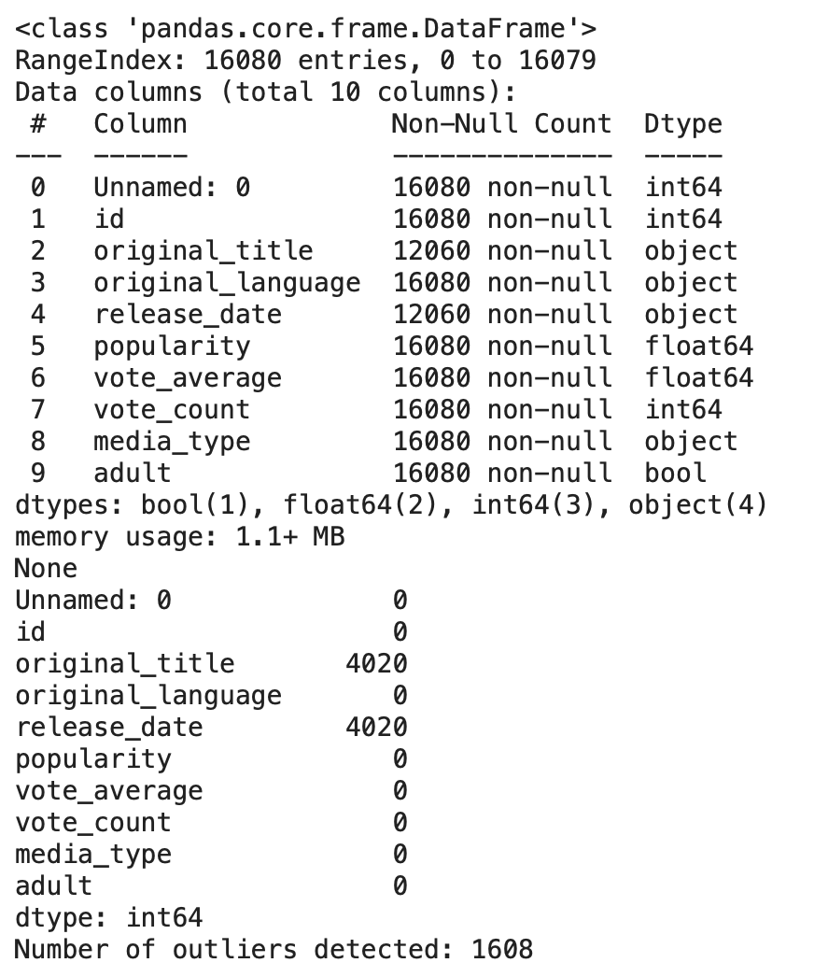
Methodology - Data Preprocessing
Dataset Loading: The dataset is loaded using Pandas' read_csv function.
Handling Missing Values: Rows with missing values are dropped to ensure data quality.
Datetime Conversion: The release_date column is converted to datetime format, and the release_year is extracted.
Outlier Detection: Outliers are identified using z-scores and removed to improve model performance.

Slide 13
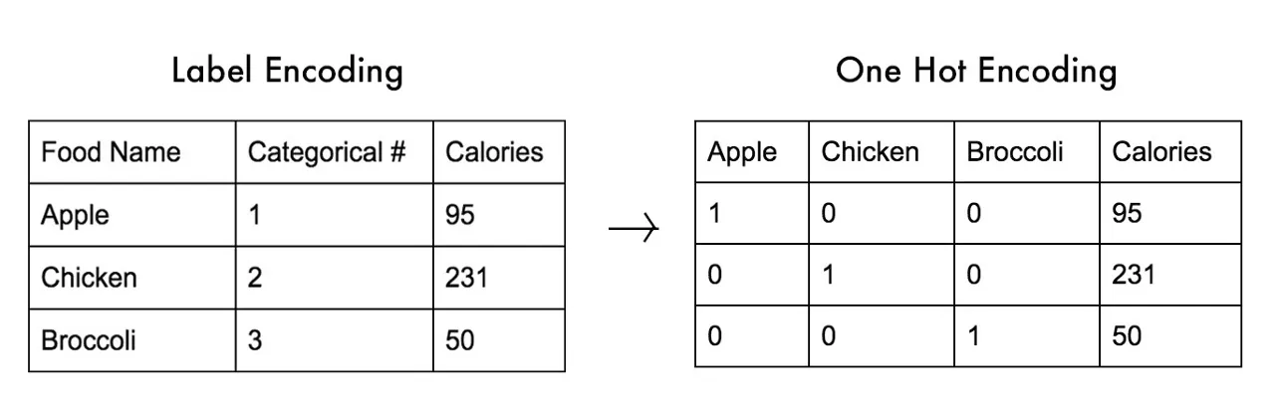
Handling Categorical Features
Encoding: Categorical features like original_language are encoded using LabelEncoder to convert them into numerical values.
Example: The original_language feature is transformed into numeric labels for the model to process.

Slide 14
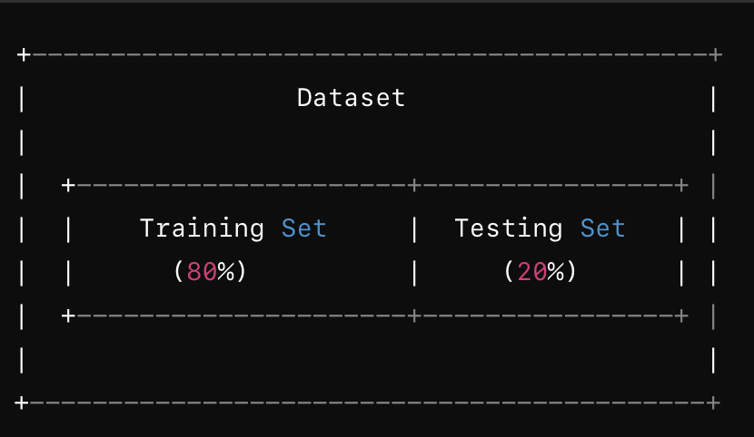
Feature Selection and Data Splitting
Feature Selection: Selected features include popularity, vote_count, release_year, and original_language.
Data Splitting: Data is split into training (80%) and testing (20%) sets using train_test_split to evaluate model performance.

Slide 15
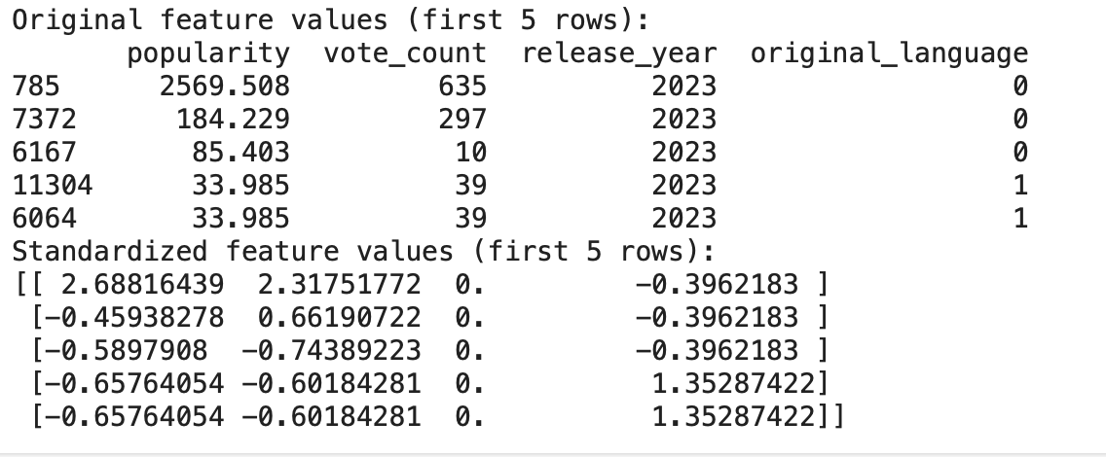
Feature Scaling
Standardization: Features are standardized using StandardScaler to ensure they have a mean of 0 and a standard deviation of 1.
Importance: Scaling is crucial for improving the performance of machine learning models.

Slide 16
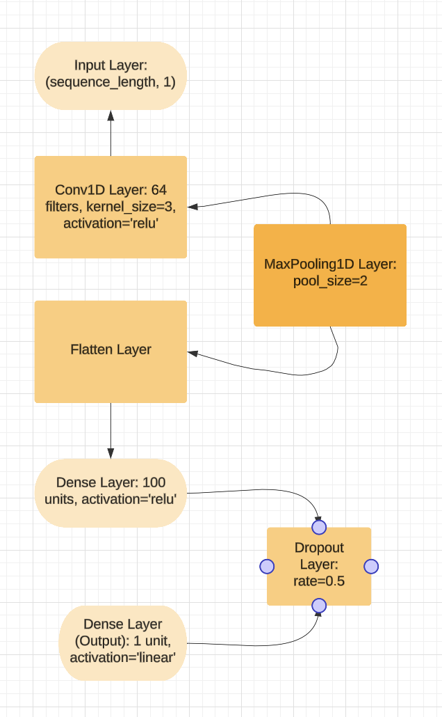
CNN Model Definition
Model Architecture: The CNN model includes layers such as Conv1D, MaxPooling1D, Flatten, Dense, and Dropout.
Activation Functions: ReLU is used for hidden layers, and a linear activation function for the output layer.
Optimizer: Adam optimizer is used for training the model.

Slide 17
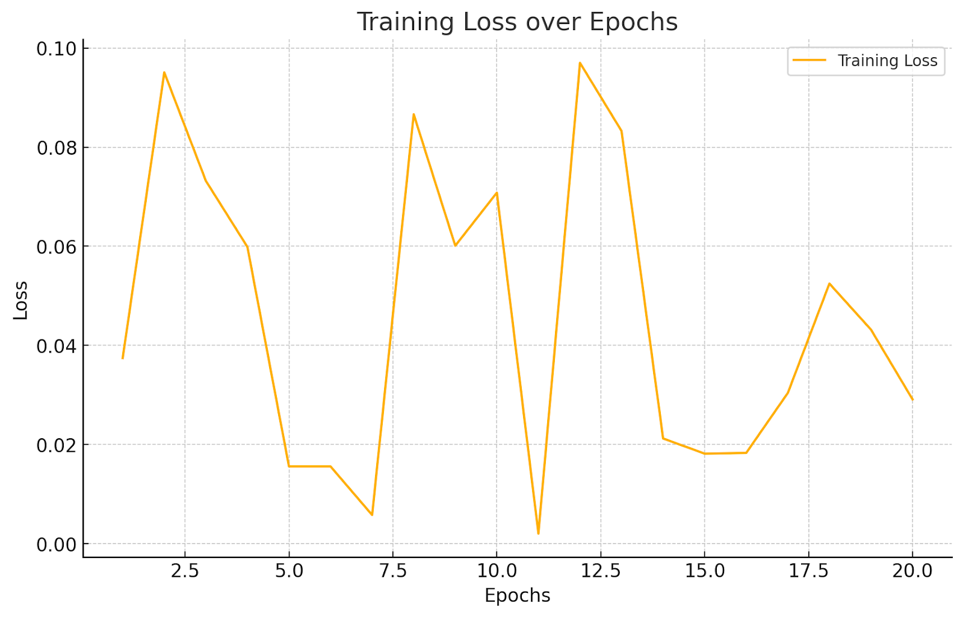
CNN Model Definition
Data Reshaping: The data is reshaped to fit the input requirements of the CNN.
Training Process: The model is trained using predefined hyperparameters such as epochs and batch size.
Hyperparameters: Example values include 20 epochs and a batch size of 32.

Slide 18
RNN Model Overview
Data Preparation:
Simulated sequential data (8361 training, 2000 testing samples).
10-time steps per sample, 1 feature.
Model:
SimpleRNN Layer: 128 units with ReLU activation.
Output Layer: Dense with sigmoid for binary classification.
Training:
Epochs: 10
Batch Size: 32
Loss: Binary Crossentropy
Optimizer: Adam
Evaluation:
Metrics: RMSE, MAE, R² Score.

Slide 19
Challenges
Data Quality and Availability: Ensuring access to comprehensive, up-to-date, and high-quality datasets can be challenging. Missing or inconsistent data may hinder model performance.
Scalability: As the user base grows, handling large volumes of data and providing real-time recommendations will require scalable infrastructure, potentially leading to increased costs and complexity.
Model Complexity: Balancing model accuracy with computational efficiency is crucial. More complex models might improve recommendations but at the cost of increased computational resources and time.
Personalization vs. Privacy: Enhancing personalization often requires more user data, raising concerns about data privacy and the ethical use of personal information.
Integration with Existing Systems: Integrating the recommendation system into existing platforms and ensuring smooth operation across different devices and interfaces can pose technical and logistical challenges.
User Adoption and Trust: Ensuring that users trust the recommendations and are willing to adopt the new system requires transparent algorithms and clear communication of how recommendations are generated.

Slide 20
Recommendations for Future Work
Model Improvement: Use advanced deep learning models and optimize hyperparameters with Grid/Random Search.
Feature Engineering: Add user demographics, content genres, and real-time behavior data. Explore interaction effects.
Data Augmentation: Expand the dataset with recent data or user-generated content to enhance model robustness.
Scalability Testing: Test scalability with larger datasets and real-time data. Consider cloud-based solutions.
User Experience: Personalize content displays and give users more control over recommendations.
Ethical Considerations: Use privacy-preserving techniques to protect user data while enhancing personalization.
A/B Testing: Continuously refine recommendations through A/B testing and adapt to user preferences.

Slide 21
References and Project Repository
TensorFlow: https://www.tensorflow.org
Keras: https://keras.io
Background Reference: https://www.bioinf.jku.at/publications/older/2604.pdf
Dataset Source: https://www.kaggle.com/datasets/priyanshuganwani09/entertainment-movies-tv-shows-database
Project GitHub Repository: https://github.com/JaimisMiyani/Entertainment-System

Slide 22

Thank you

